Slide 1
Process and Signals
session 12

Slide 2
Agenda
Process Creation
fork, waitpid and exec system calls
Basic concepts of the signals
Generating and handling the signals

Slide 3
Processes in linux
Process ID, parent process id
User process
Kernel process
First user process (init)
First kernel process (scheduler)

Slide 4
Requirements of process creation
Address space allocation
4 important memory segments of process (from Users perspective)
data (global variables - initialized and uninitialized data)
code (execution statements)
user stack (method execution)
heap (dynamic memory allocation)
Memory segments allocated from other sources
shared memory
shared libraries
Important segments of process (from kernels perspective)
task_struct (store info about process which will be used by the kernel)

Slide 5
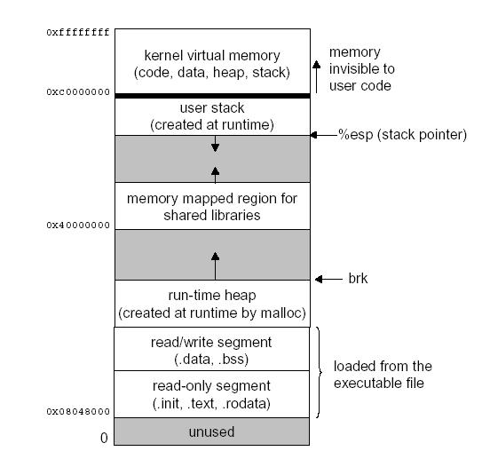
Process image

Slide 6
Ways of creating process
The egg and hen problem
Process image copy (efficiency, copy-on-write)
I need a process to create a process
fork
exec(usually after call to fork)

Slide 7
Process creation using fork
fork() - function call to create a process
Interesting return type ( failure case → < 0 and success case → = 0 in child > 0 in parent )
What will happen after fork (in parent and child)
Parent should wait for child to exit/terminate (wait, waitpid)
wait allow to get exit status of child (WEXITSTATUS)
What happens if parent does not wait for child?
How much process we can create ?
fork bomb

Slide 8
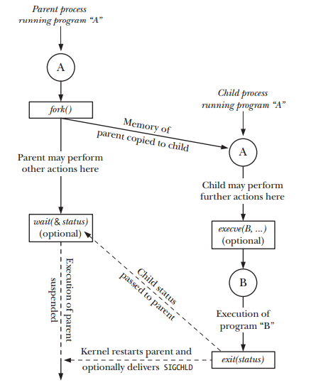
fork

Slide 9
Sample program
main ()
{
pid_t pid = fork();
if ( pid == 0 )
{
printf (“Child code\n”);
// execl (optional) or execute own instructions
exit(status);
}
else if (pid > 0 )
{
printf(“Parent code\n”);
// perform work
// wait for child by calling wait or waitpid
}
else
{
printf(“fork failed\n”);
exit(-1);
}
}

Slide 10
Process creation - exec
Why I need the same instructions in parent and child
instructions of child may differ from child
exec function call come in use in such situations

Slide 11
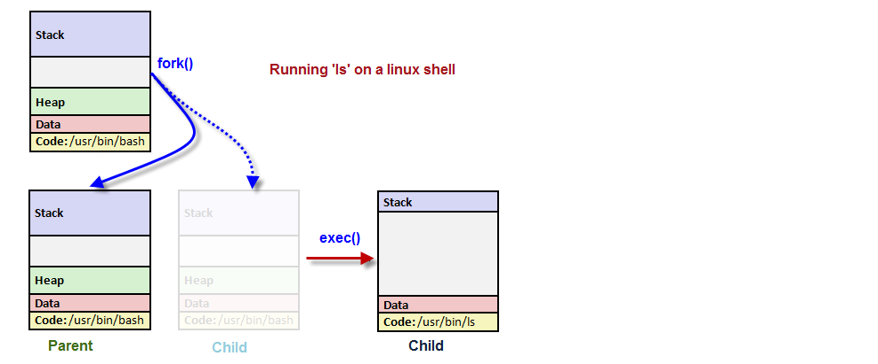
shell way of fork and exec

Slide 12
exec example
main ()
{
pid_t pid = fork();
if ( pid == 0 ) {
printf (“Child code\n”);
// perform some work
# first two arguments are programs
execl(“prorgam”, “program”, arg1, arg2, …, argn); # program should be specified with absolute path
exit(status);
}
else if (pid > 0 ) {
printf(“Parent code\n”);
// perform work
// wait for child by calling wait or waitpid
}
else {
printf(“fork failed\n”);
exit(-1);
}
}

Slide 13
Signals
Need
Software interrupt
sender of signals
default response to the signal

Slide 14
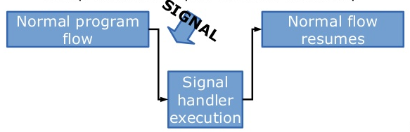
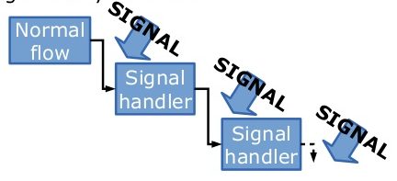
Signals
Simple Signal
Nested Signal

Slide 15
Signal generation
Errors within program (not all error but errors which require signal generation)
External events ( expiration of timer, arrival of some input from a process)
Explicit requests (using kill function or kill command)
synchronous vs asynchronous (based on generation)

Slide 16
Delivery of signals and actions
blocked
generated → pending
delivered
Actions
ignore
provide a signal handler
default action
usual default action is to terminate the process
core dumps in program errors (usually segmentation fault)

Slide 17
Standard signals
Sr No | Signal Type | Signals
1 | Program errors signals | SIGFPE - floating point operation or division by zero SIGSEGV - segmentation fault SIGABRT - an error detected by program itself and generated by calling abort default action - terminate process
2 | Termination signals | SIGINT - Ctrl+c, default action to terminate the process, can be ignored, handled SIGTERM - Polite way to tell process to terminate, can be handled or ignored (kill) SIGKILL - kill -9, asking forcefully to terminate, can not be handled or ignored SIGHUP - to report disconnection of terminal SIGQUIT - Ctrl+\, simillar to SIGINT, produces core dump default action - terminate process
3 | Timer signals | SIGALRM - expiration of timer that measures real or clock time SIGVALRM - Expiration of timer that measures CPU time SIGPROF - expiration of of a timer that measures both CPU time used by the current process, and CPU time expended on behalf of the process by the system, used for profiling default action - terminate program

Slide 18
Standard signals
Sr No | Signal Type | Signals
4 | Asynchronous I/O Signals | SIGIO - if a file descriptor is ready to perform I/O, for sockets and terminals SIGURG - out of band or urgent pointer data arrives on the socket default action - ignore the signals
5 | Job control signals | SIGSTOP - stopping execution of process Ctrl+z default action - suspend process SIGCONT - Resuming execution of process default action - resume process execution
6 | Operation Error signals | SIGPIPE - broken pipe, writing on pipe, fifo failed due to closing or invalidation of it default action - terminate process
7 | Miscellaneous Signals | SIGUSR1 and SIGUSR2 - left for user to perform IPC using signals User signals default action - terminate the process

Slide 19
Sending signals
int kill(pid_t pid, int signum)
send signum signal to process with pid as pid.
if pid > 0 → send signal to process with pid as pid
if pid == 0 → send signal to all processes in the same process group as sender
if pid < -1 → send signal to process group whose process group pid is abs(pid)
if pid == -1 → If sender process is privileged then send signal to all processes except some system processes. If not privileged send signal to all processes with the effective user ID
Process can send signal to itself kill(getpid(), signum), getpid returns PID
return value 0 indicates signal sent successfully in case of 1 process, to one of the process in case of sending signal to group of processes. 1 indicates failure to send signal to all processes in case of sending signal to group of processes or to single process in case of sending signal to single process
kill <signum> <pid> → command to send signal from terminal

Slide 20
Handling signals
Signal handler function
void handler(int signo) { //code to handle signal }
registering signal handler for signal
sighandler_t signal(int signum, sighandler_t action)
signum - signal number
action →
SIG_IGN → ignore the signal
SIG_DFL → call default signal handler for this signal
handler function name → call particular handler function defined to handle the signal with signal number as signum

Slide 21
code snippet - generating and handling signals
// Signal handler method
void sig_handler(int signo)
{
// Signal handling code
}
int main()
{
// Registering handler to the signal
signal(SIGUSR1, sig_handler);
// Generating signal from inside process
kill(getpid(), SIGUSR1);
// kill(getpid(), SIGKILL); suicide
}

